Slide 1
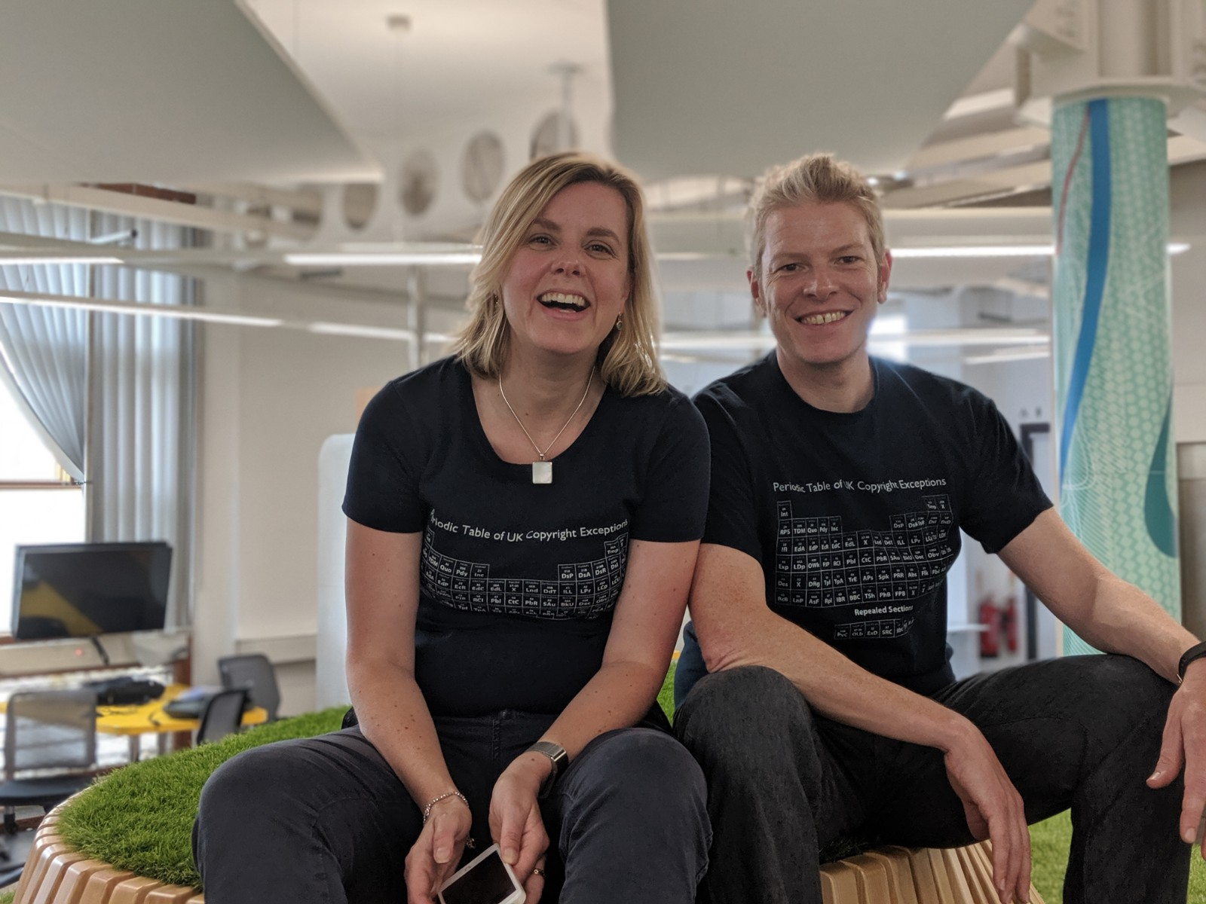

Copyright for Community Archivists
TaNC Community Archives Digital Preservation Toolkit
Chris Morrison & Jane Secker
copyrightliteracy.org
January 2025

Slide 2













































What is copyright?
Works
(The things it protects)
Licences
(Legal use with permission)
Usages
(The activities it regulates)
Exceptions
(Legal use without permission)
C

Slide 3














Copyright Works
Literary
Artistic
Musical
Dramatic
Broadcast
Sound Recording
Film
Typography
Public Domain
Crown Copyright
Database
Moral Rights
Performance
Non Qualifying
https://copyrightliteracy.org/resources/copyright-the-card-game/
C
Notes:
No registration. Originality. Idea expression.

Slide 4
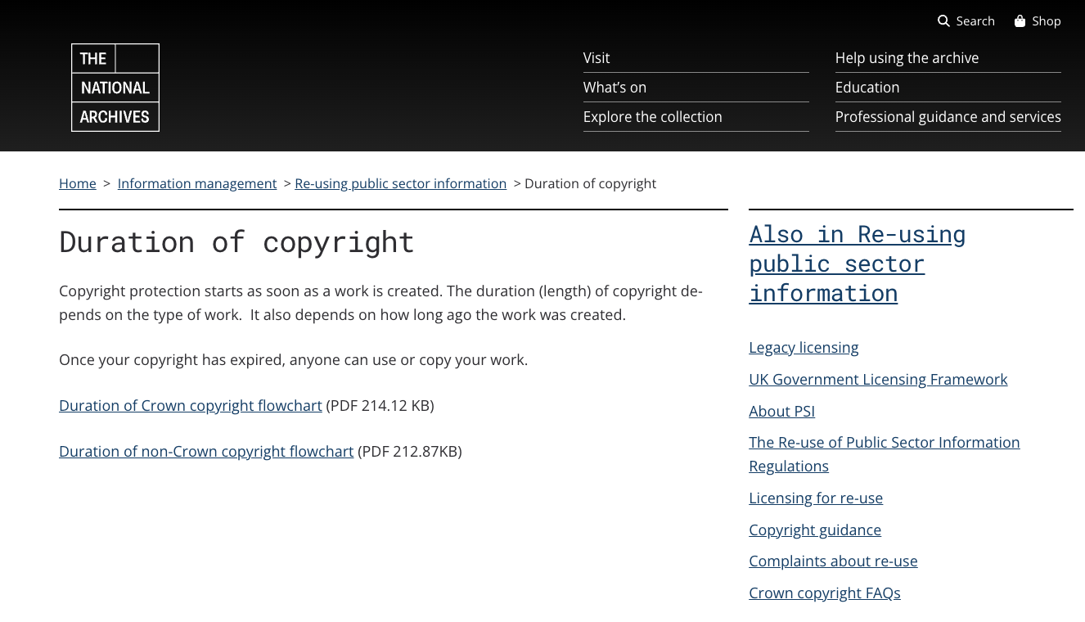
TNA duration of copyright
https://www.nationalarchives.gov.uk/information-management/re-using-public-sector-information/duration-copyright/

Slide 5
Usages
Copying
Issuing copies to the public
Rental or Lending
Public Performance
Communication to the public
Adaptation
C

Slide 6
How can I use this work legally?
Exceptions
Licences
Risk
C

Slide 7
Licences
Library electronic resource licences
Website terms of use
CLA Licence (books and journals
Newspapers (NLA)
Creative Commons
Open Government Licence (Crown copyright)
Your employer owns the copyright
You own the copyright
C
Icons from Copyright the Card Game CC BY - https://copyrightliteracy.org/resources/copyright-the-card-game/

Slide 8
Applying licences to archive content

Slide 9
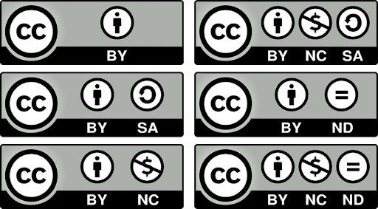
Creative commons
https://creativecommons.org/

Slide 10
Copyright Exceptions for digital preservation
Preservation for libraries and archives (S42 CDPA)
Providing copies of published works (S42A CDPA)
Providing single copies of unpublished works (S43 CDPA)
Providing access via dedicated terminals (S40B CDPA)
J
Icons from Copyright the Card Game CC BY - https://copyrightliteracy.org/resources/copyright-the-card-game/

Slide 11


Fair Dealing and Fair Use
J
New York City photo by Renan Kamikoga on Unsplash, Winston Churchill photo by Arthur Osipyan on Unsplash CC-0

Slide 12
Fair Dealing
Is what you’re doing ‘fair’ on a case-by-case basis. Ask yourself the following questions:
have you used the work in a way that stops the rights holder from selling the work, or making use of it in the way they want to?
have you used more of the work than you need to for your purpose?
J

Slide 13
Risk Management
What’s the likelihood that your activity infringes copyright?
What is the likelihood that the copyright owner will discover and object to your activity?
what is the impact (both financial and reputational) if the copyright holder was to take action against you or your institution?
C

Slide 14

Orphan works
Definition:
“A work – such as a book, a piece of music, a painting or a film – in which copyright exists, but where the copyright owner is either unknown or cannot be located” (copyrightuser.org)
Risk managed approach commonly used by libraries and archives when making digital collections available online
The UK Intellectual Property Office offer a Licensing Scheme for orphan works (UK use only and limited to 7 years)
A ‘diligent search’ required in either scenario

Slide 15
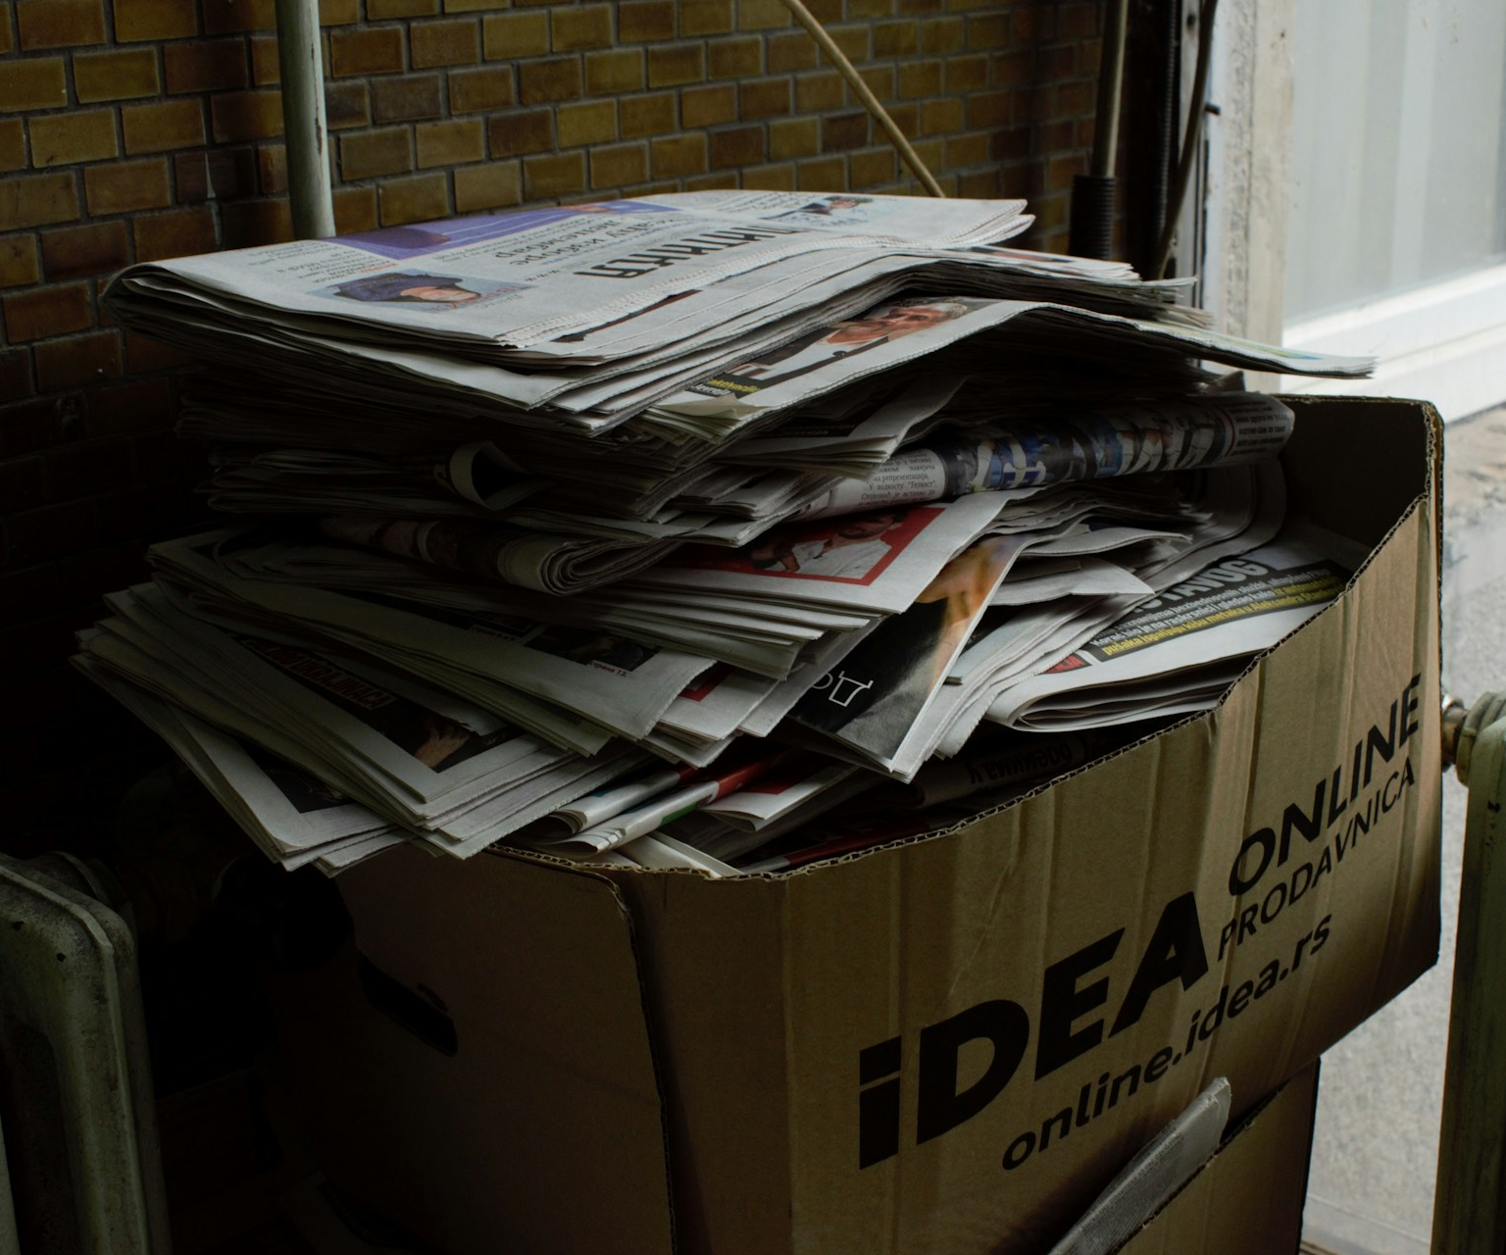
Consider the following scenario
An amateur historian has donated her collection to a local historical society of which she was a member.
The collection includes letters, books, journals, photographs, ephemera and videos in a range of different formats.
How would the society archive address the copyright considerations of digitising the collection, preserving it and making it available to the public?
Photo of papers in box by vuk burgic on Unsplash
J

Slide 16
Things to consider
Are the items in copyright? If not, no rights clearance is needed
Who owns the copyright in the collection items? Get permission from the historian for the archive to use and reuse content they have created.
If relying on preservation exceptions, are the items now in the archive’s ‘permanent collection’?
Are any of the collection items ‘orphan works’ and if so, what is the archive’s due diligence process?
Should the archive use a risk managed approach, or is the UK Orphan Works Licensing Scheme more appropriate?
Notes:
Each item will need to be assessed however the item must be in the permanent collection for the preservation exception to apply.
What is its potential value to users in being made available in digital format?
Are the objects being digitized solely to preserve the items, or to make them available more widely e.g. from an online catalogue or website?
Are they still in copyright?
If no, then easier to digitize, but consider what copyright statement or licence might be applied to the digital objects?
If yes, then can a rights holder be traced to obtain permission to digitize?
Who owns the copyright in any in-copyright collection items and can their permission be obtained to digitize and share the collection?
Are any items orphan works? If yes, might IPO Orphan works scheme be a suitable route? (note the licence needs to be renewed every 7 years and only covers UK uses)

Slide 17
In summary
Copyright automatically arises in any original creative expression recorded in a fixed form
Copyright licences provide permission from the copyright owner to use their works and come in many different forms from closed to open
Copyright is not just about licences; exceptions allow for many archival and preservation activities without the authorisation of the copyright owner
Copyright exceptions for preservation allow community archives to digitise in-copyright material, but not necessarily make them publicly available online
In many situations you will need to think about ‘risk management’ – particularly when working with ‘orphan works’ where the copyright owner cannot be identified or located
C/J

Slide 18
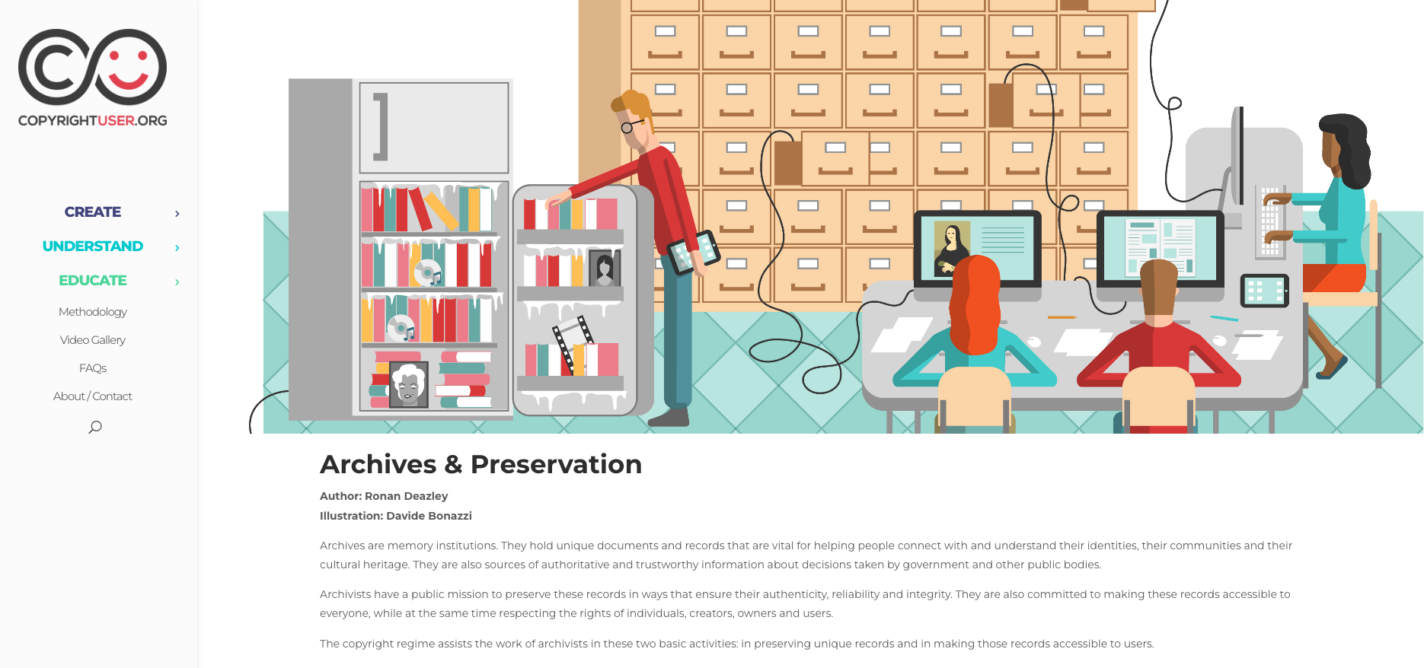
Find out more: copyrightUser.org
https://www.copyrightuser.org/educate/archives/

Slide 19
USEFUL LINKS
Bodleian Copyright Guidance - https://www.bodleian.ox.ac.uk/ask/copyright
Copyright, Designs & Patents Act 1988 - https://www.legislation.gov.uk/ukpga/1988/48/contents
Copyright Literacy - https://copyrightliteracy.org/
Copyright User – https://copyrightuser.org (see in particular the sections on Archives and Preservation and Orphan Works)
EnDOW Due diligent search tool - https://diligentsearch.eu/
Intellectual Property Office (2020) Orphan works and cultural heritage. Available at: https://www.gov.uk/guidance/orphan-works-and-cultural-heritage-institutions
TNA Copyright Duration – https://www.nationalarchives.gov.uk/information-management/re-using-public-sector-information/duration-copyright/

